Slide 1
CP3401 Assignment 2
Part 3
Team Members
Lum Kwan Wei Brandon - 13379339
Udaya Bhaskar Reddy Malkannagari - 13368171
Anumolu Sandeep Prasad - 13156974
Alvin Yeonata -13255785

Slide 2

Part 3
Case Study
Bionic Prosthetic Limbs in Health and Medicine

Slide 3
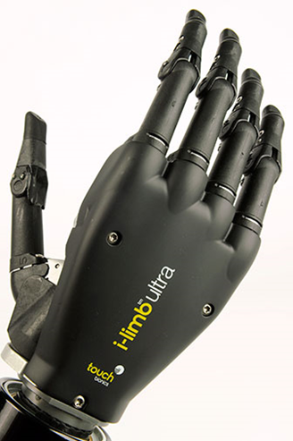
Background on organization/application
Touch Bionics
- World’s leading Prosthetic provider
- Developed first commercial active prosthetic
- Touch Bionics I-Limb
- Became commercially available in 2007
Notes:
-------------------
Talking points
-------------------
The history of Touch Bionics began with a program of work conducted at the Princess Margaret Rose Hospital in Edinburgh from 1963, starting with comprehensive research into developing prosthetic solutions for children affected by Thalidomide.
The company was initially called Touch EMAS, EMAS standing for Edinburgh Modular Arm System. In 2005 it was re-branded Touch Bionics to communicate the dynamism of the company's products and the future focus of its prosthesis technology. In medicine, bionics means the replacement or enhancement of organs or other body parts by mechanical means.
TouchEMAS was established to develop ideas which emerged from over 20 years of research and development in artificial limbs within the National Health Service in Edinburgh, Scotland. This work gained international recognition from 1993 when an innovative partial hand prosthesis was developed and then followed by the world's first fitting of an artificial powered shoulder to Scottish Hotelier Campbell Aird in 1998. In 2000 a clinical trial of a children's partial hand system (ProDigits) in Nottingham also received international recognition.
The i-LIMB System comprises a powered shoulder, elbow, wrist and the newly launched hand. The i-LIMB Hand is unique and a world first in that it is human-like with articulating or bending fingers and possesses a range of grips similar to those used in daily activities. The hand is based on the patented idea of powered prosthetic digits
----------------
References
----------------
http://www.touchbionics.com/about/history
http://www.touchbionics.com/news-events/news/touchbionics-press-release-launch-articulating-hand

Slide 4
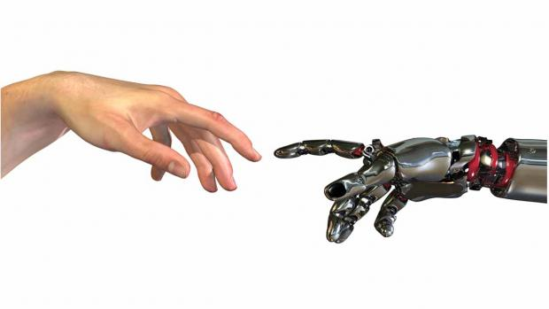
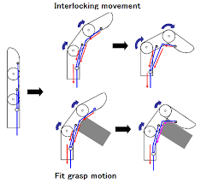
Why is it important?
Bionic hand with a human touch. Users
control the bionic hand with their own
muscular impulses.
Fingers that move independently and bend at natural joints
Notes:
--------------------
Talking points
--------------------
The world's first prosthetic hand with moving fingers is poised to transform the lives of millions of amputees.Users will control the bionic hand through their own muscular impulses, and it will enable them to perform functions such as turning keys and gripping objects.
Gow's hand, which has sophisticated electronics coated with skin-effect silicone rubber, will have a moving thumb and fingers. In addition the hand's fingers will curl or articulate, so more closely resembling the movements of human hands.
The i-LIMB System comprises a powered shoulder, elbow, wrist and the newly launched hand. The i-LIMB Hand is unique and a world first in that it is human-like with articulating or bending fingers and possesses a range of grips similar to those used in daily activities. The hand is based on the patented idea of powered prosthetic digits
----------------
References
----------------
http://www.touchbionics.com/news-events/news/touchbionics-press-release-launch-articulating-hand
http://www.touchbionics.com/news-events/news/worlds-first-prosthetic-hand-moving-fingers

Slide 5
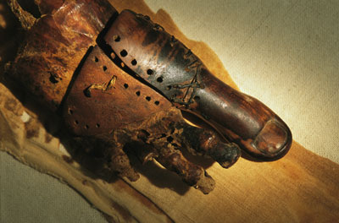
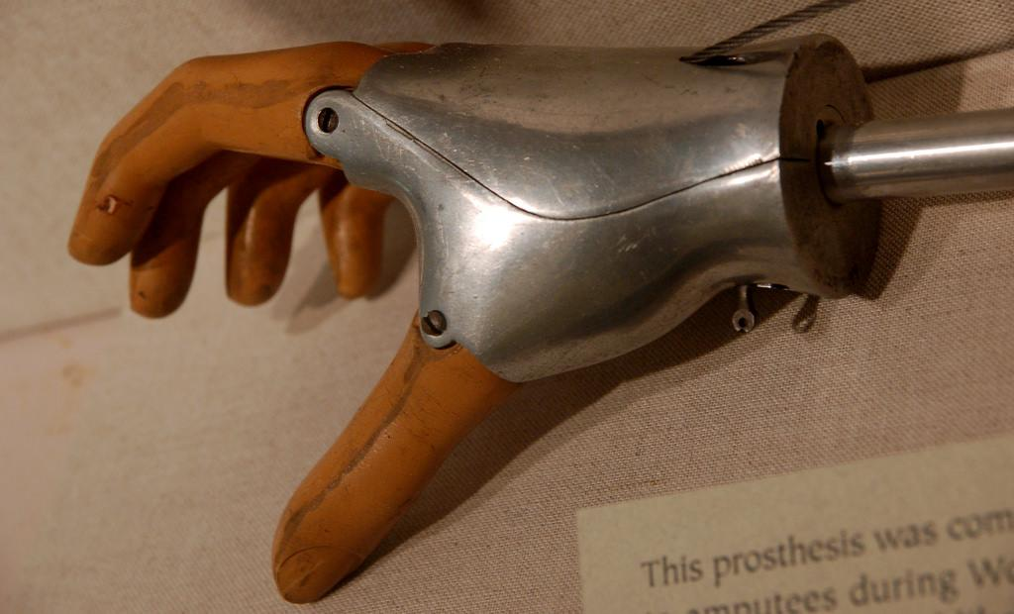
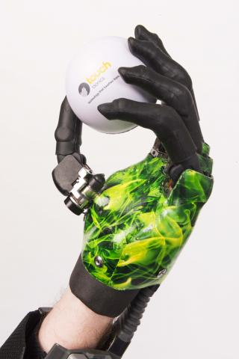
How was it before the application of Disruptive Technology
The first prosthetic limbs date
back to 950 B.C
Don’t survive long
Made of wood or iron
Before 1840, most people died after amputation
surgery
2007, fully functional bionic hands was released
Notes:
Before
hard to control
Hard to maintain
After
Better control
durable
Can do many things
Before 1840
Died due to side-effects of shock, infection and blood loss
Invention of anesthesia
2007
Touch bionics was the first to commercially sell bionic hands
References
http://www.touchbionics.com/news-events/news/amputees-embracing-world%E2%80%99s-first-bionic-hand
http://science.howstuffworks.com/prosthetic-limb1.htm
https://www.teachengineering.org/lessons/view/uoh_pirates_lesson01 - 1840 statistics reference

Slide 6
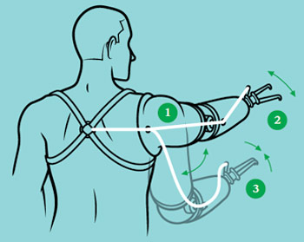
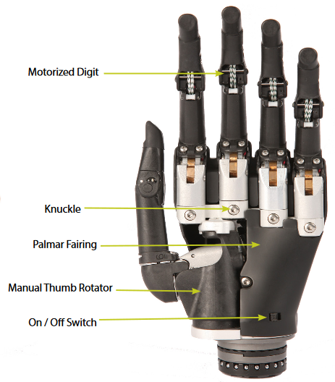
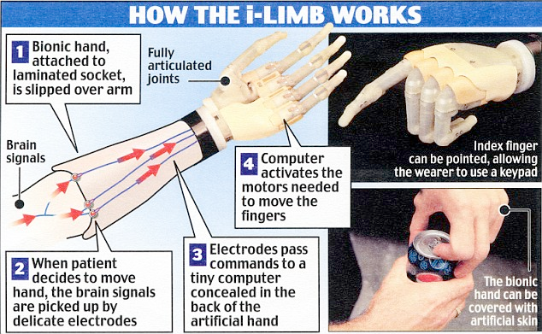
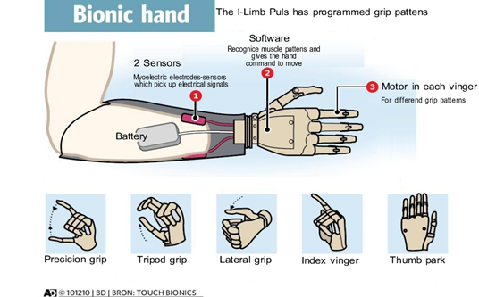
Application of the Disruptive Technology
How was Disruptive Technology applied in the case study? Be as specific as possible
i-Limb, the first commercial, fully-articulate, artificial hand
The Hosmer-Dorrance Hook
The i-limb access
Major advancement in prosthetic attachments
One of Time Magazine’s top 50 innovations of 2008
Taken from dailymail.co.uk
Notes:
- More than 20 years of R&D
- In 2007, Touch Bionics launched i-limb, the world’s first-to-market myo-electric (controlled by electrical signals generated by the wearer’s muscles) prosthetic hand with individually articulated fingers.
-The powered prosthetic is a major advance on previous prosthetic hands which are hook-like and have limited flexibility. The joints are fully articulated with an individual motor for each digit, and the hand does not require surgery to be fitted to a patient’s stump.
One of Time Magazine’s top 50 innovations of 2008
Limbless Association’s Prosthetic Product Innovation Award (December 2008)
References:
Definition of “first-to-market”, Retrieved from: http://www.businessdictionary.com/definition/first-to-market.html
Touch Bionics by Ossur Product Catalog, Retrieved from: http://www.touchbionics.com/sites/default/files/files/Touch%20Bionics%20by%20%C3%96ssur%20Catalog%20add-on_Master2017_final_0.pdf
“i-LIMB Hand wins Prosthetic Product Innovation Award”, published by TouchBionics, 1 December 2008. Retrieved from: http://www.touchbionics.com/news-events/news/i-limb-hand-wins-prosthetic-product-innovation-award
“Time Magazine’s Best Inventions of 2008”, Time.com. Retrieved from: http://content.time.com/time/specials/packages/article/0,28804,1852747_1854195_1854132,00.html

Slide 7

Application of the Disruptive Technology
An average of about £50,000 for an i-Limb solution
Profitable and remains well-funded, total reported revenue of £15 Million in 2015.
“Five of our board members invested £5,000 each to help David build his prototype. It had what we look for in a startup – a clever, difficult-to-copy technology that had global reach. And that was the start of our 13-year journey with Touch BIonics”
- Niki McKenzie, Archangel Investment Director.
As quoted in an article titled “The bionic span: how a scottish prothetic hand developer attained global reach.”, published by Janice Morton, 20 June 2016
Notes:
“There is a limited market for manufacturers and the demand is relative statistic, no amount of advertising is likely to significantly increase the demand. In such cases, it becomes very difficult to justify the research and development costs necessary to bring advanced prosthetic devices to market.”
“The full i-LIMB prosthesis is significantly more expensive than other competitive solutions. An average i-LIMB solution for an amputee is roughly $50K (but can reach $70K). For the near term, funding for an individual i-LIMB is limited to a few specific sources – insurance companies processing claims for car accidents or work-place accidents (covered by workman’s compensation insurance) or the government (primarily the U.S. government in the form of the military or the Veteran’s Administration).”
“The $50K figure cited above includes the costs associated with custom tailoring the prosthesis and training the amputee. Fitting any prosthesis is analogous to a dentist’s role in making dentures or creating and fitting a crown. As a result, the prosthetist becomes the gatekeeper with regard to adoption of any new technology, such as the i-LIMB.”
Remains well-funded, Investors include Archangel Informal Investments, TriCAP, Clydesdale Bank and the Scottish Co-investment Fund.
References:
Niki Mckenzie’s profile page. Retrieved from: http://archangelsonline.com/team/niki-mckenzie/
RBR staff, 22 April 2009,“Touch Bionics Focuses on i-LIMB hand, Upper Body Prosthetics”. Retrieved from: https://www.roboticsbusinessreview.com/health-medical/touch-bionics-focuses-on-i-limb-hand-the-award-winning-bionic-hand/
“Touch Bionics sales reach £15 million in 2015”, published by Touch Bionics, 19 January 2016. Retrieved from: http://www.touchbionics.com/news-events/news/touch-bionics-sales-reach-%C2%A315-million-2015
Morton, Janice, 20 June 2016, “The bionic span: how a Scottish prosthetic hand developer attained global reach”. Retrieved from:
https://medtechengine.com/article/touch-bionics-attained-global-reach/
Mcdermott, Kerry, 23 April 2013, “Britain's first bionic boy: Patrick, 16, overjoyed as he gets robotic hand so advanced it can be controlled via smartphone app”. Retrieved from: http://www.dailymail.co.uk/sciencetech/article-2313507/i-limb-ultra-revolution-The-16-year-old-boy-Britains-app-controlled-bionic-hand.html

Slide 8

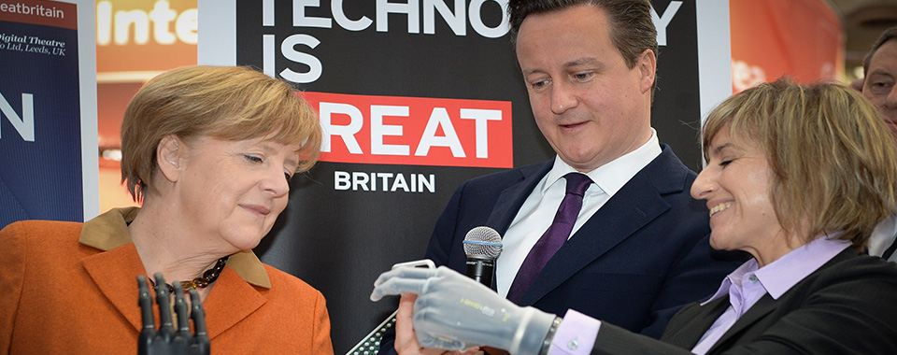
Organisational Changes after implementation of Disruptive Technology
TouchBionic has evolved through bionic
feature development and regional expansion
since their first commercial appearance in 2007
Internationally recognized for innovation and disruption of Medical Prosthetics industry
Notes:
-------------------------------
Major accomplishments
--------------------------------
2007 - Unveils World’s First bionic hand
2008 - acquires livingskin, provides world’s most advanced realistic aesthetic covers for prosthetics
2009 - Unveils World’s First Bionic Finger
2011 - Wins International Business Awards for ‘Most Innovative Company of the Year in Europe’
2013 - Receives highest Scottish honor, engineering hall of fame
2014 - Receives Queen’s honor (CBE)
2016 - Acquired by Global Orthopedic Leader, Össur
---------------
Expansion
----------------
2008 - U.S, China markets
2009 - U.K
2013 - Germany
-----------------
References
-----------------
http://www.touchbionics.com/news-events/news/touch-bionics-wins-international-business-awards
http://www.touchbionics.com/news-events/news/touch-bionics-executive-receives-high-scottish-honour
http://www.touchbionics.com/news-events/news/touch-bionics-founder-receives-queen%E2%80%99s-honour
http://www.touchbionics.com/news-events/news/touch-bionics-unveils-world%E2%80%99s-first-bionic-finger
http://www.touchbionics.com/news-events/news/%C3%B6ssur-acquires-touch-bionics

Slide 9
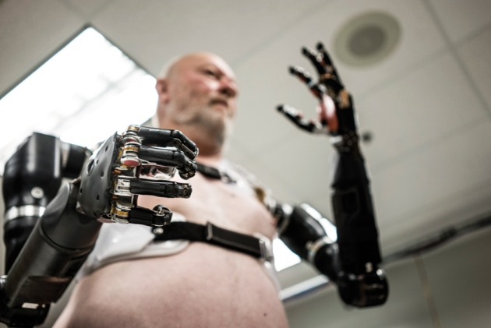
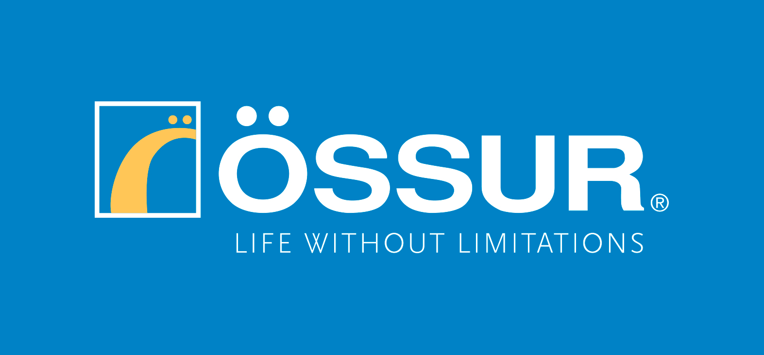
Organisational Changes after implementation of Disruptive Technology
Company has since developed other critically acclaimed technology such as Bionic Fingers in 2009 and the iLimb pulse in 2010
Acquired by Global Orthopedic Leader, Össur in 2016 for improving quality of life for amputees worldwide
Notes:
-------------------
Talking Points
-------------------
Inspired and fueled by the previous Bionic Hand DT (Disruptive Technology), TouchBionics have continued to excel at innovation in their industry by acquiring and developing advanced orthopedic technology to further disrupt dated prosthetic technology and increasing their consumer base rapidly.
A major organisational change for TouchBionics was its acquisition by Global Orthopedics Leader, Össur who shares the common goal of globally impacting the prosthetics industry by improving the quality of life of amputees worldwide.
----------------
References
----------------
http://www.touchbionics.com/news-events/news/touch-bionics-unveils-world%E2%80%99s-first-bionic-finger
http://www.touchbionics.com/news-events/news/touch-bionics-unveils-new-i-limb-pulse
http://www.bbc.com/news/uk-scotland-scotland-business-36014113
https://www.ossur.sg/about-ossur/news-from-ossur/92-oessur-acquires-touch-bionics

Slide 10
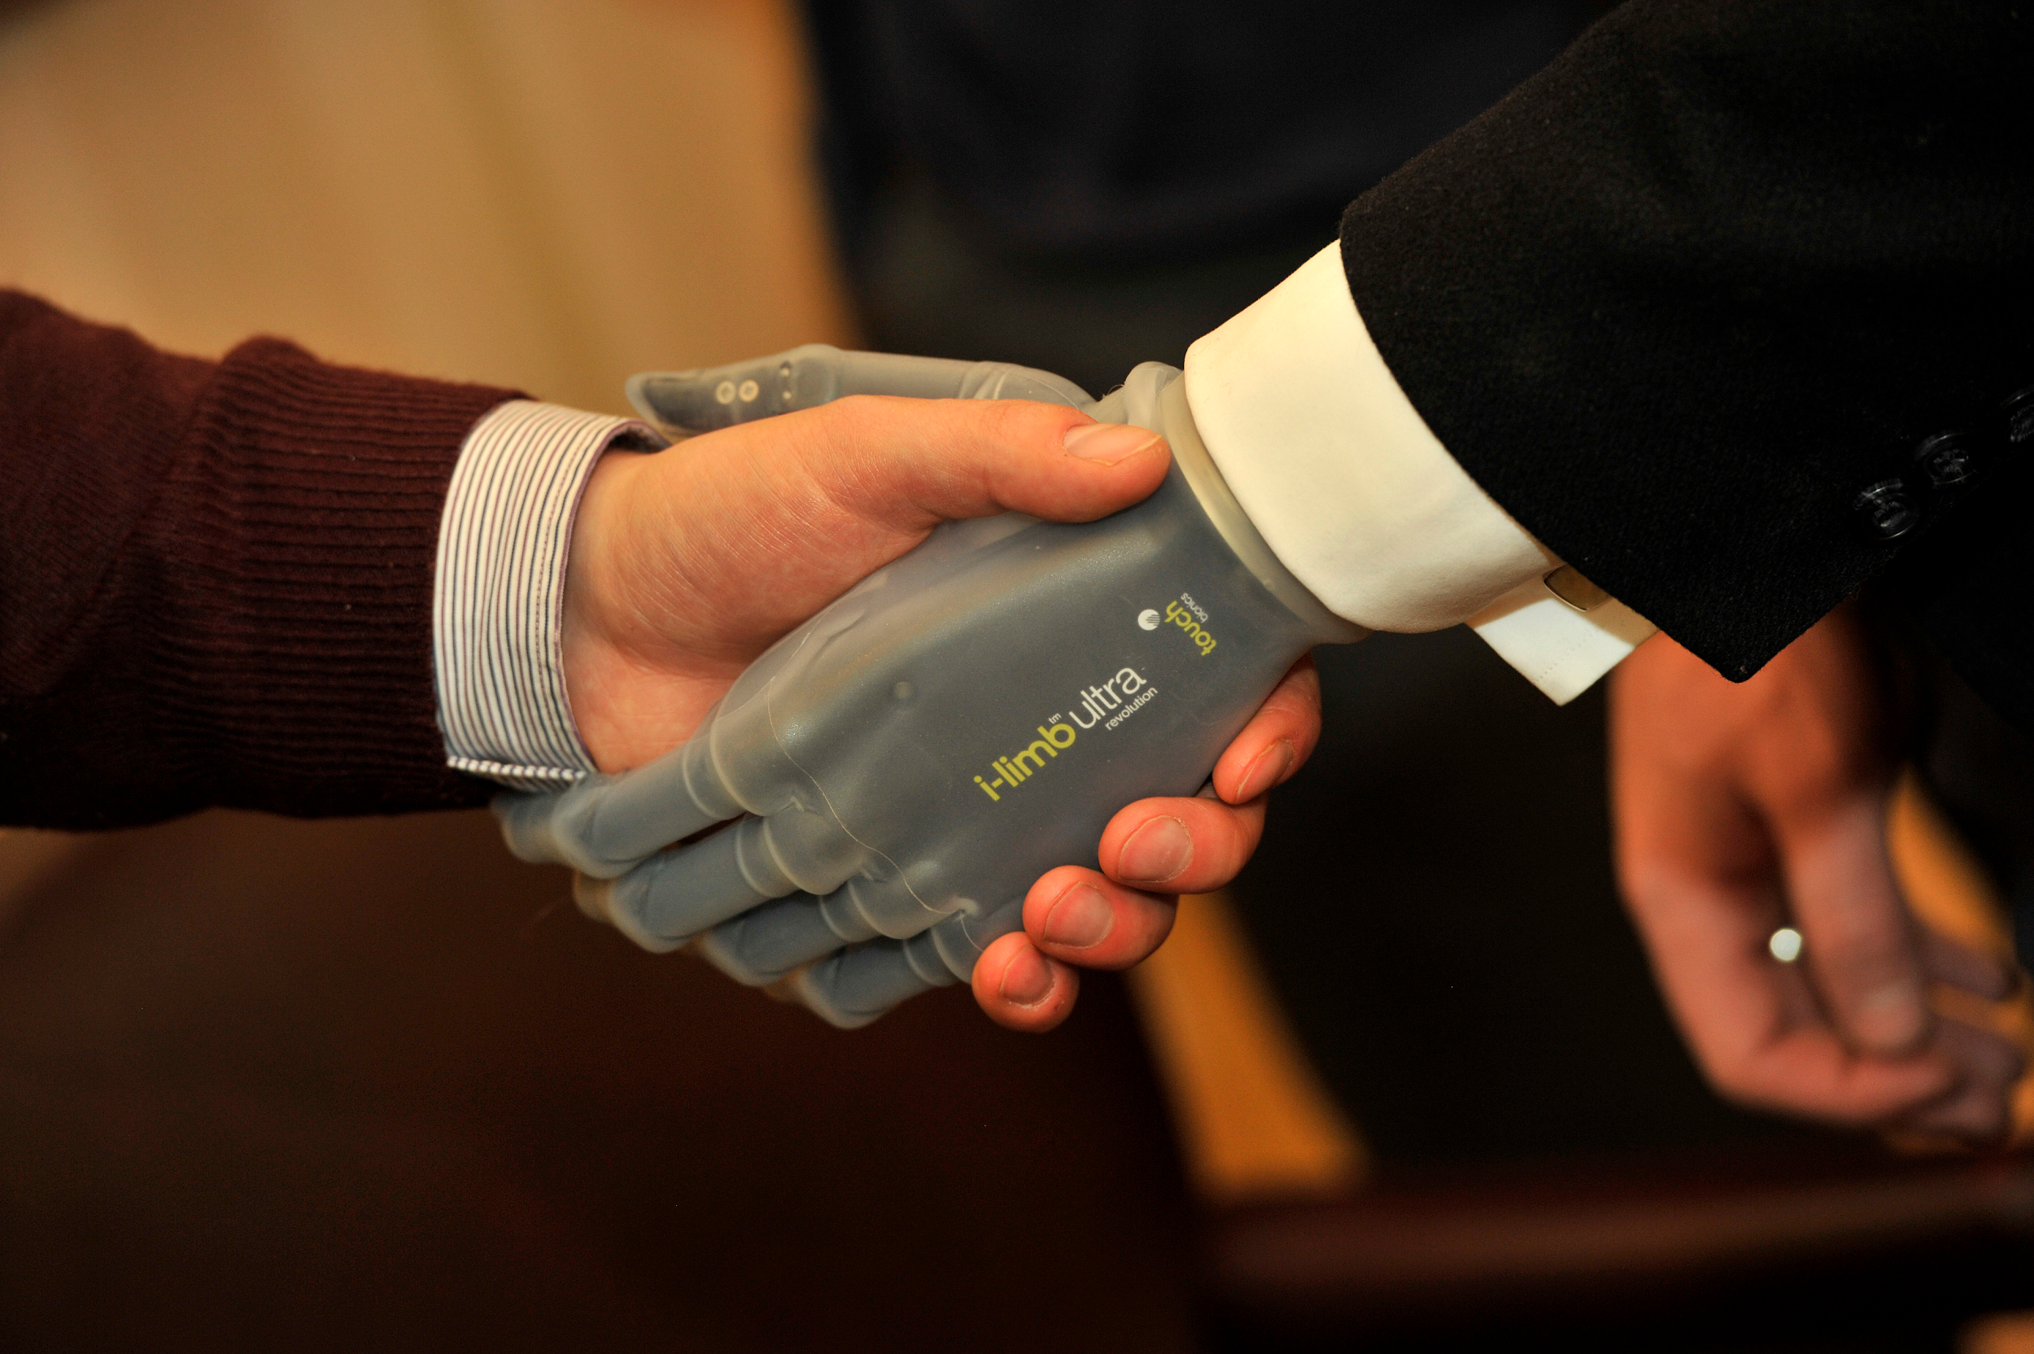

Prediction for future…
Since company has been acquired by Global Orthopedic Leader - Össur in 2016, will promote products and innovate at rapid pace
Company has unveiled new prosthetic wrist technology since the acquisition, and continues to strive towards global expansion
Notes:
----------------
References
----------------
http://www.touchbionics.com/news-events/news/%C3%B6ssur-acquires-touch-bionics
http://www.touchbionics.com/news-events/news/touch-bionics-introduce-digitally-controlled-supro-wrist
https://medtechengine.com/article/touch-bionics-attained-global-reach/

